Slide 2
Airlines Vs Number of Flight carriers:
AirLines Vs Number of Flights
Top 5 Cities with highest Average Arrival and Departure Delay
Top5Delays-Dodged
Average WeatherDelay by Month
WeatherDelay
Which Routes are typically the most delayed?
Airport Origin delay per month?
Airport Origin delay per day/hour
Add a new column to our data frame, Dep_Delayed, a binary variable:
True, for flights that have > 15 minutes of delay False, for flights that have <= 15 minutes of delay – Logistic Regression, Binary Classifications – Random Forest, xgBoost

Slide 3
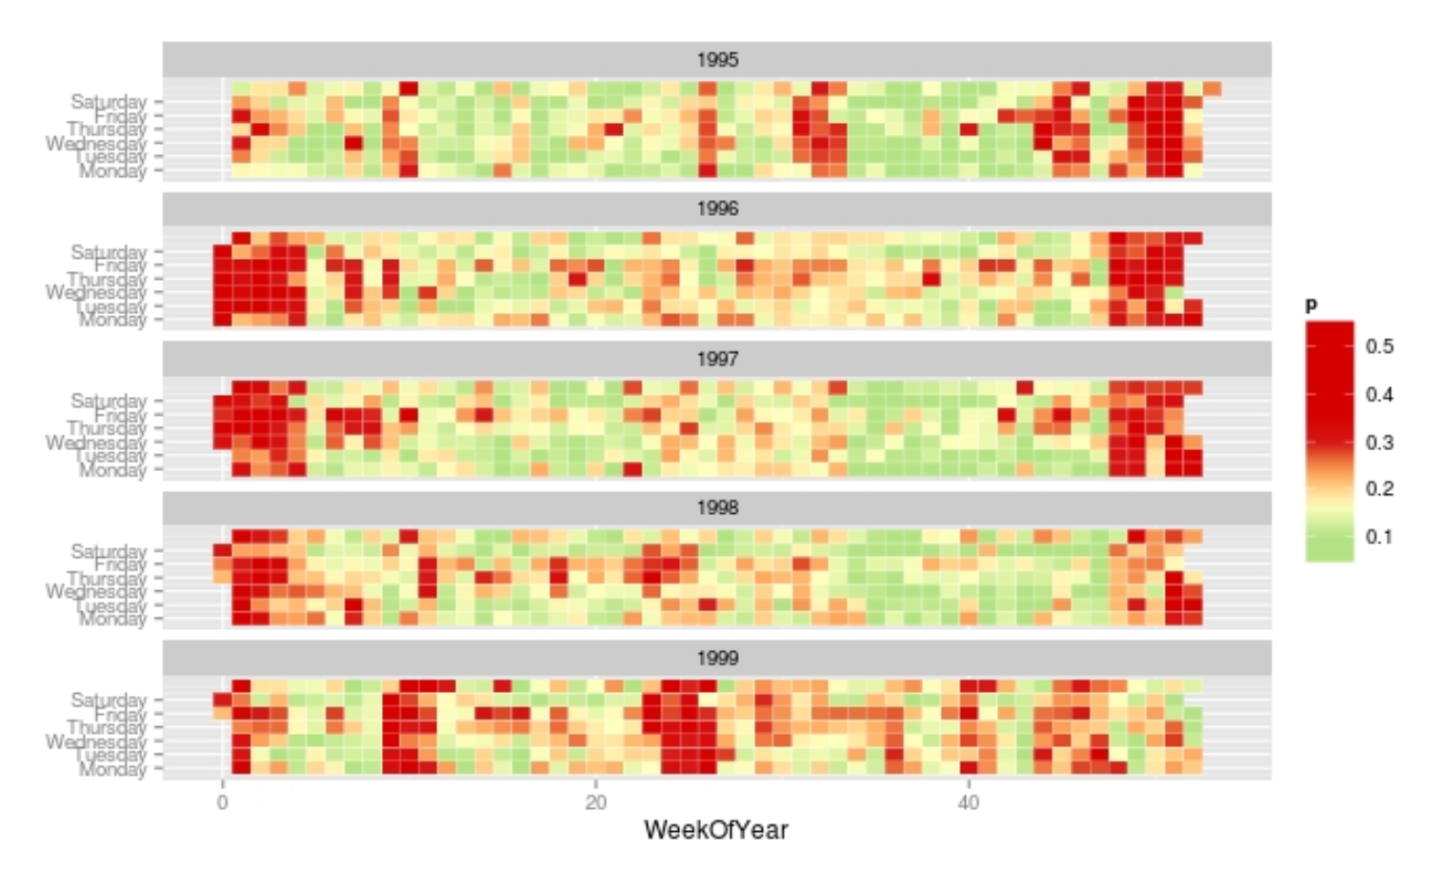
Airlines Vs Number of Flight carriers:
AirLines Vs Number of Flights
G = ggplot(A[s,], aes(WeekOfYear, DayOfWeek, fill = percent)) + scale_y_continuous(breaks=0:6, labels=c("Sunday","Monday","Tuesday","Wednesday","Thursday","Friday","Saturday")) + theme(axis.title.y=element_blank()) + geom_tile(colour = "white") + scale_fill_gradientn(colours=col) + facet_wrap(~ Year, ncol = 1) print(G)

Slide 4
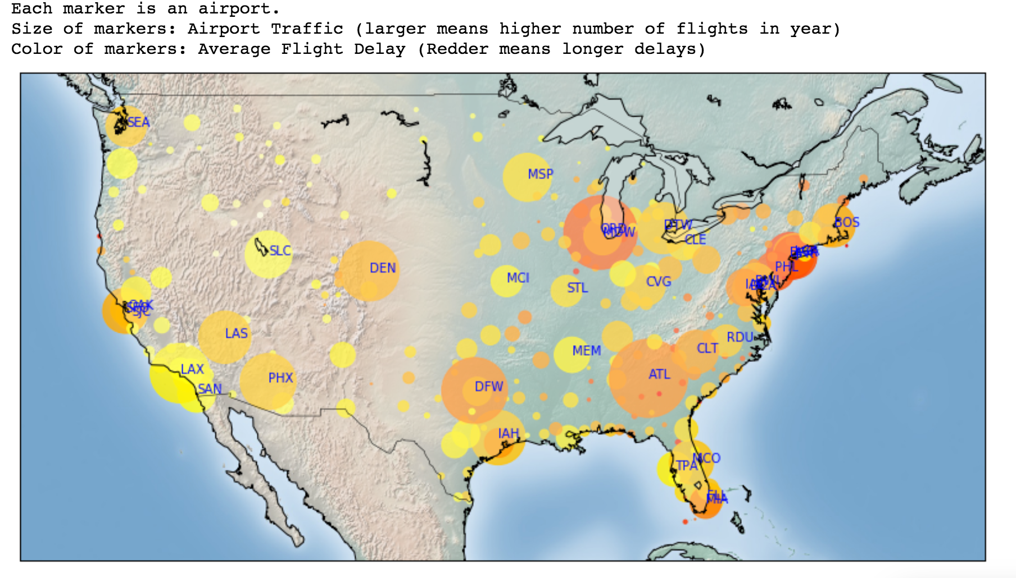

Slide 5
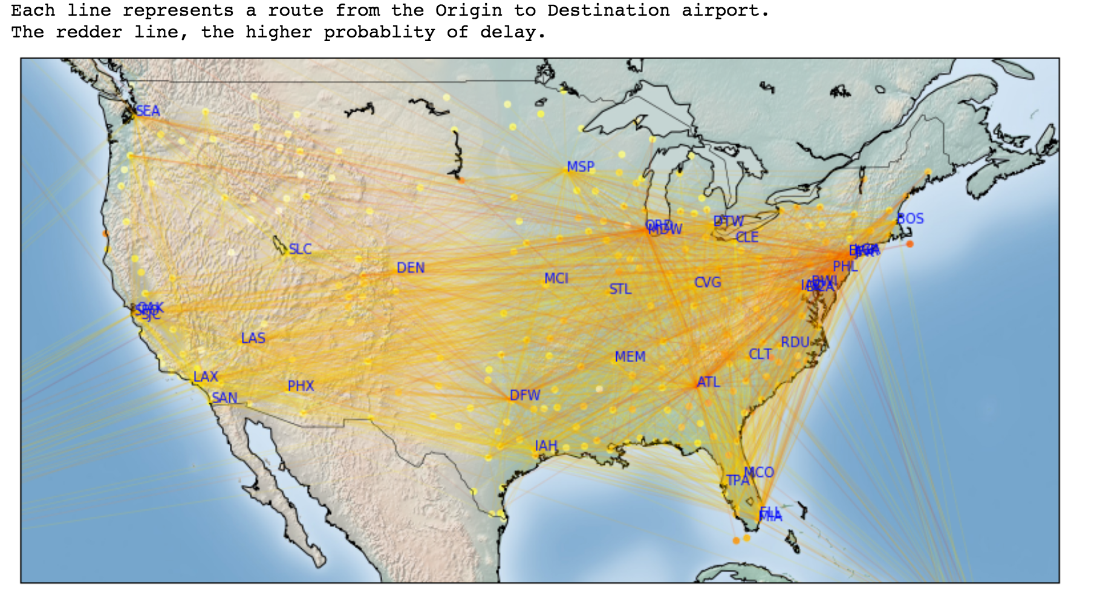

Slide 6
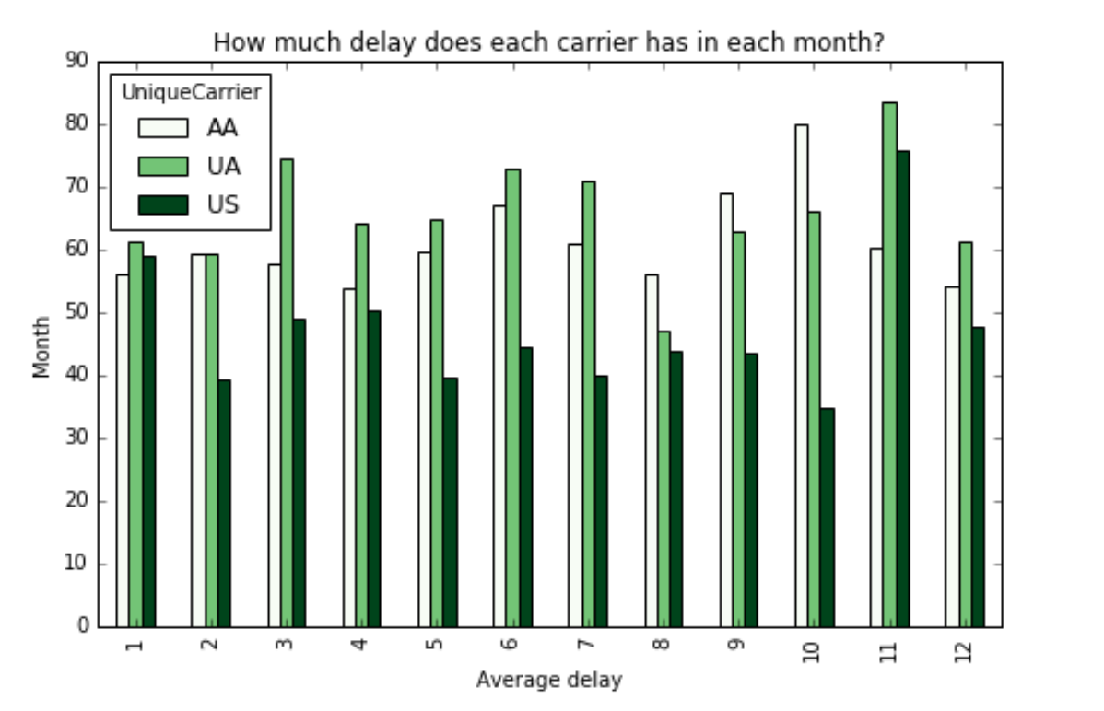

Slide 7
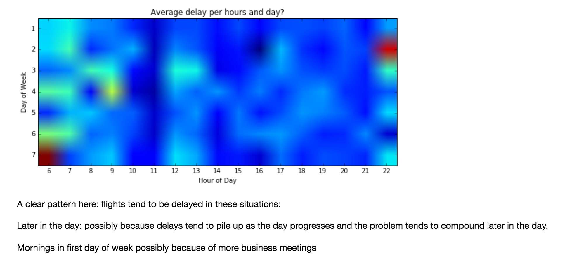

Slide 8




Review
Live Dashboard
IoT Devices
IoT Edge
(single node)
NiFi Hub
Data Broker
Data Store
Column DB
HDFS/S3
HBase/Cassandra
IoT Devices
IoT Edge
(single node)
Data Center
(on prem/cloud)

